Slide 1
How to use PHP with a MySQL Database
Update

Slide 2
Objectives
Learn how to change data in the database
Display a record in a form.
Use the UPDATE command

Slide 3
Using the UPDATE Command
UPDATE command is used to change data in a table. UPDATE contacts SET first = ‘Bob’ WHERE id = ‘9’;
If you don’t specify a where clause, all rows will be updated in the table.
No way to update multiple rows with different data.
You can update more than one field at a time.

Slide 4
Updating Data in PHP
Make a connection to the database.
Create a safe query with the SQL command.
Run the query.

Slide 5
The Real Way …
Get the primary key of the record to update.
Make a connection to the database.
Create a safe query with the SQL command to find the matching record.
Run the query.
Display the result in a form. When the user submits the changes.
Connect to the database.
Create a safe query with the SQL command to update the matching record.

Slide 6
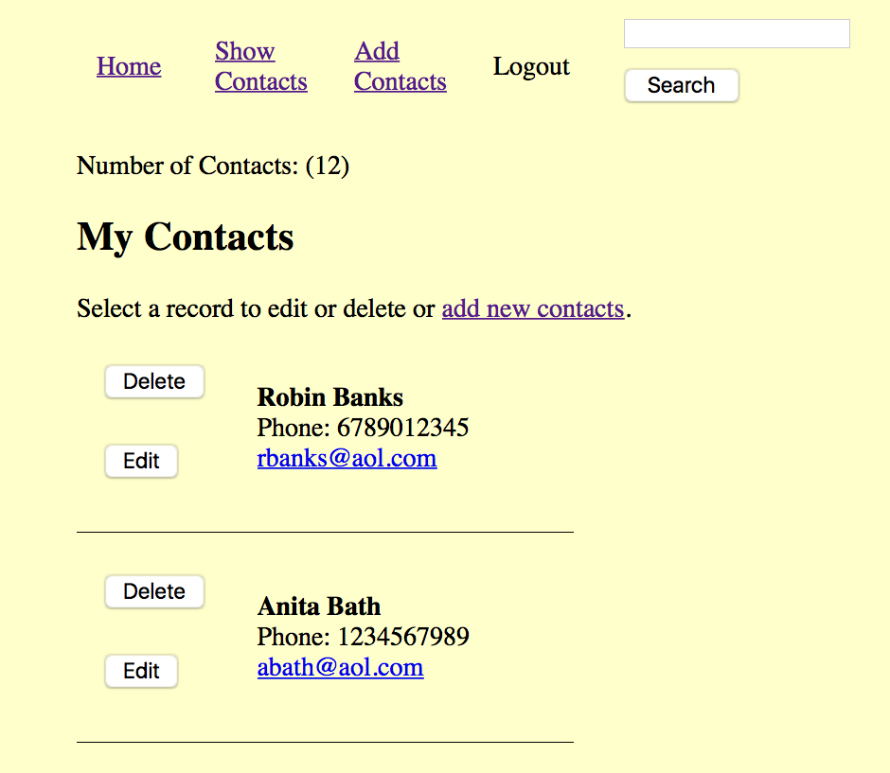
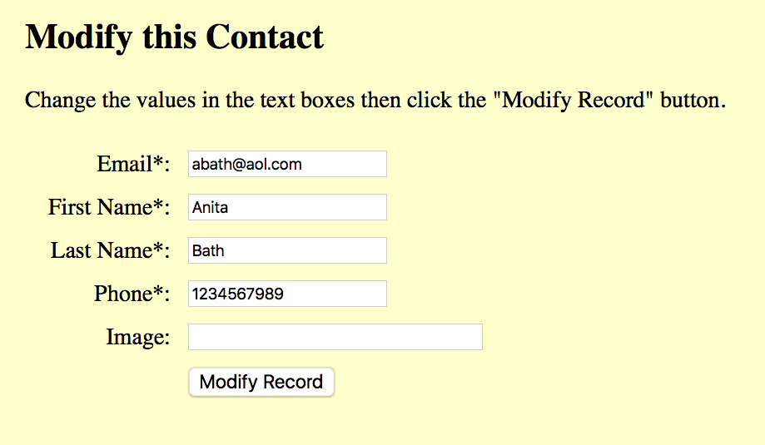
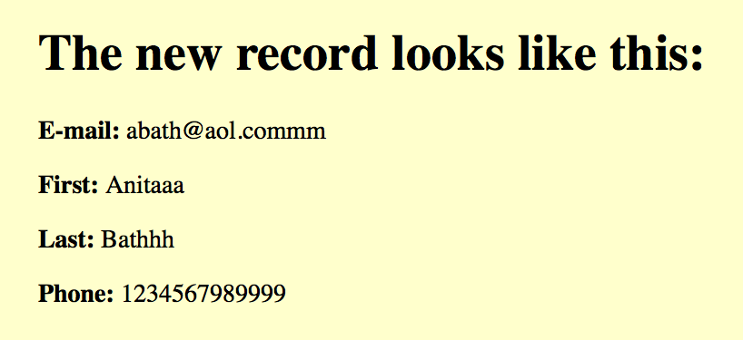
showcontacts.php
updateform.php
update.php

Slide 7
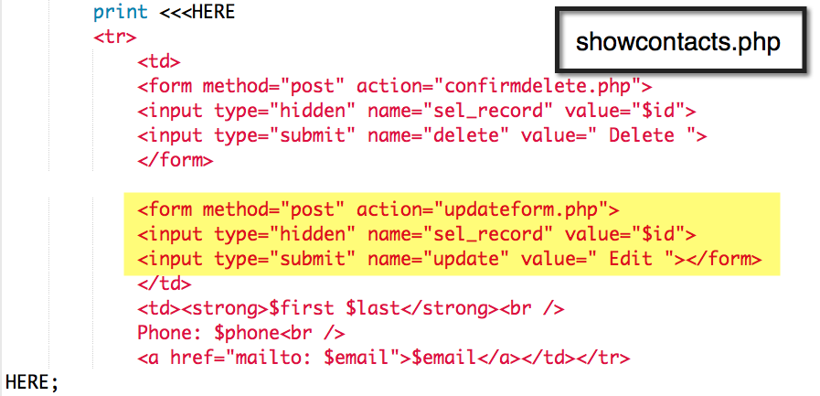

Slide 8
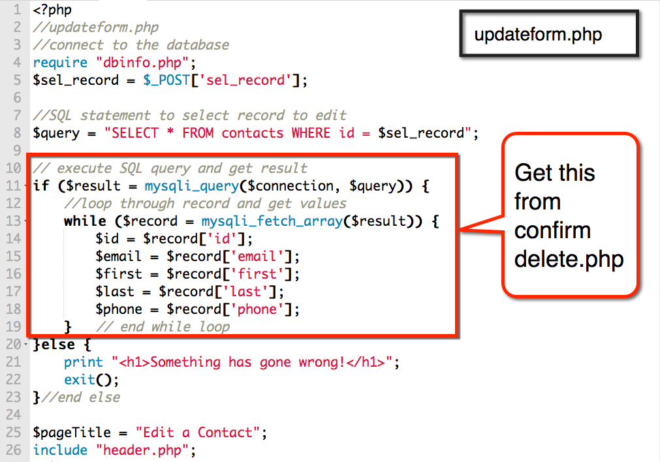

Slide 9
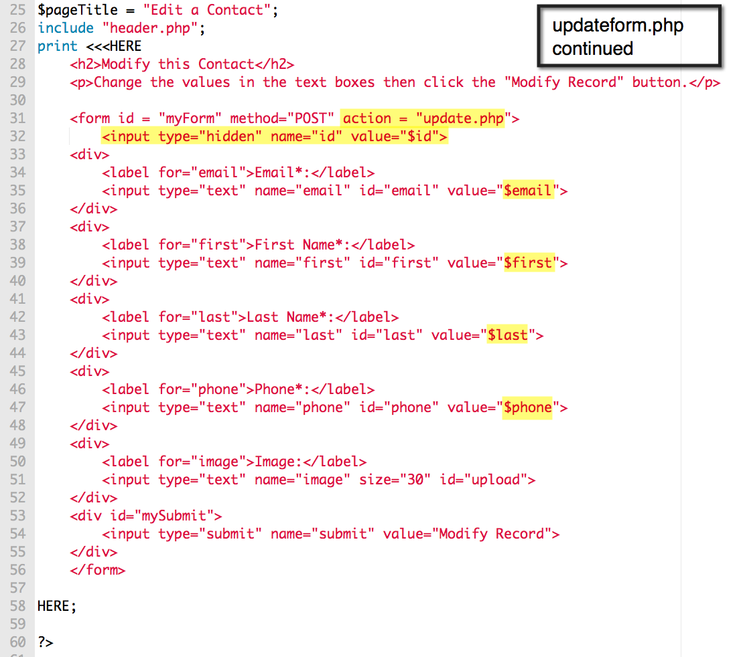

Slide 10
showcontacts.php
updateform.php
update.php

Slide 11
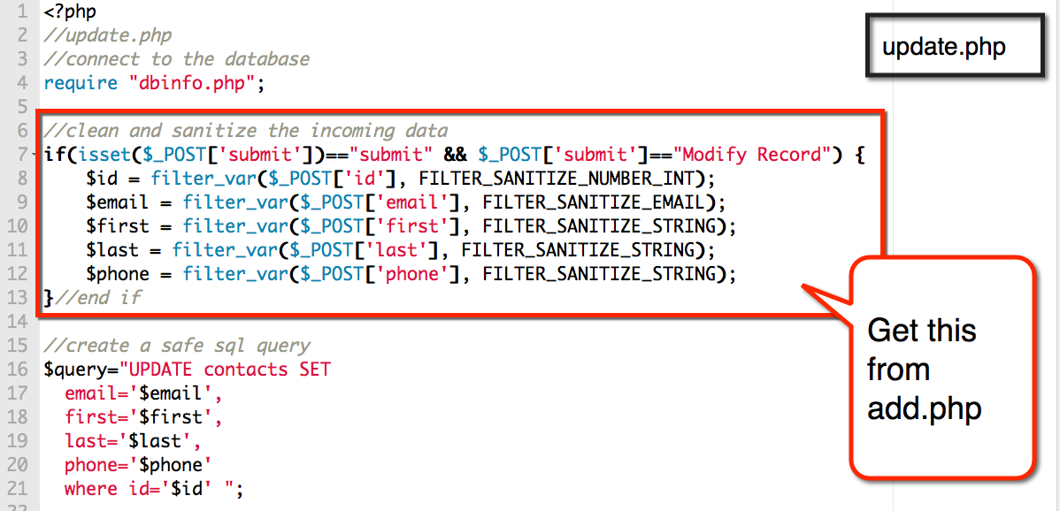

Slide 12
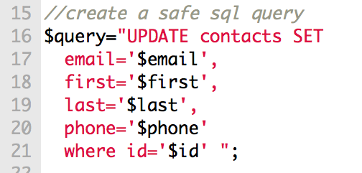

Slide 13
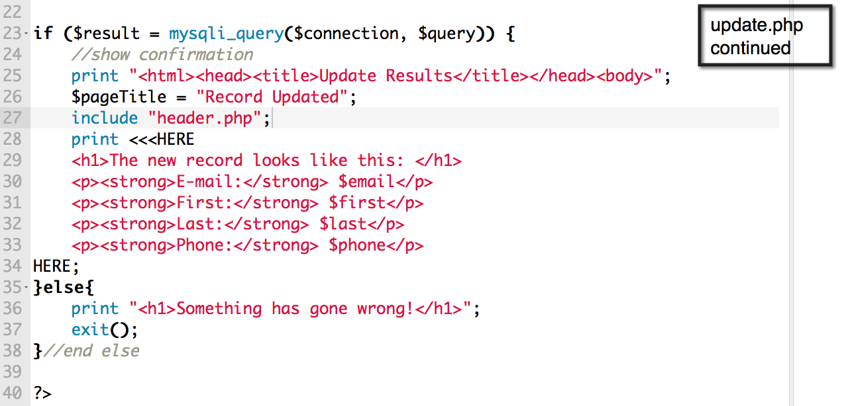

Slide 14
SCRUD Lab
Search
Create
Read
Update
Delete
See if you can connect to your Aliens Database and Update records that match a pattern in your table.
This is the Update component of the lab.

